Slide 1
Solar Tracker
Physics Major Project

Slide 2
Presented by
Samyak jhaveri 39
Vanshika Gupta 32
Navid kagalwala 42
Rhea Gupta 31
Anya jain 36
Manav Hirani 35

Slide 3
Introduction
A solar tracker is a device that orients a payload towards the sun. Payloads are usually solar panels, parabolic troughs, Fresnel reflectors, lenses or the mirrors of a heliostat.
They are used to minimize the angle of incidence between the incoming sunlight and the payload. This increases the amount of installed power generating capacity.

Slide 4
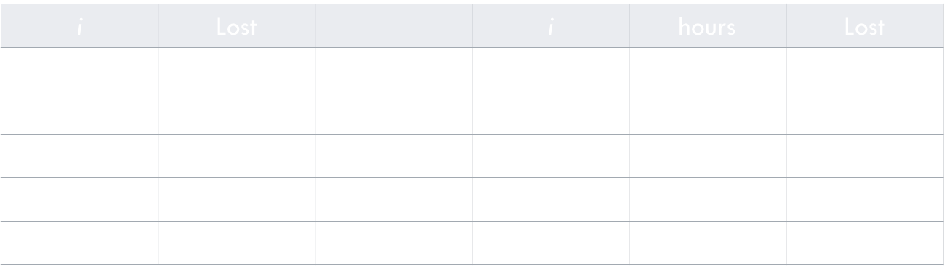
BASIC Concept
Sunlight has two components, the "direct beam" that carries about 90% of the solar energy, and the "diffuse sunlight" that carries the remainder. As the majority of the energy is in the direct beam, maximizing collection requires the Sun to be visible to the panels for as long as possible.
The energy contributed by the direct beam drops off with the cosine of the angle between the incoming light and the panel. In addition, the reflectance (averaged across all polarizations) is approximately constant for angles of incidence up to around 50°, beyond which reflectance degrades rapidly.
Direct power lost (%) due to misalignment (angle i ) where Lost = 1 - cos(i)

Slide 5
NEED Of a solar tracker
To increase solar panel output
To enable maximum efficiency of the panel
To maximize power per unit area
To be able to grab the energy throughout the day

Slide 6
Types of solar Trackers
Single axis solar tracker
Dual axis solar tracker
Single axis solar trackers can either have a horizontal or vertical axle. The horizontal type is used in tropical regions where the sun gets very high at noon, but the days are short. The vertical type is used in high latitudes(such as the UK) where the sun does not get very high, but the summer days can be very long.
Double axis solar trackers have both a horizontal and a vertical axle and so can track the suns apparent motion exactly anywhere in the world. This type of system is used to control astronomical telescopes, and so there is plenty of software available to automatically predict and track the motion of the sun across the sky. Dual axis trackers track the sun both east-to-west and north –to-south for added power and output and convenience.

Slide 7
OUR PROJECT- DUAL AXIS SOLAR TRACKER
COMPONENTS
Tools: Wire cutter, several small screw drivers, Rubber feet, Cable wrap
Electronics : Arduino Uno + USB Cable, Arduino Sensor Shield, 2 x 9g Metal Gear Servos, 1 x 5 Port Terminal Block, 1 x 4 Port Terminal Block (or 3 port will do), 4 x 10K Ohm Resistors, 4 x Light Detecting Resistors,4 x JST Socket Connector Cables, Jumper Wires
Optional electronics: 5.5V Solar Cell, LED Volt Meter
Hardware: The screws that came with your servos , 4 x M3 Screws + Nuts in around 14-16mm length, 4 x Size 2 Wood Screws at a 1/4th inch length, or some M1 Screws of similar length, 20 X 8-32 Screws at 1/2 inch length plus nuts, 1 x 8-32 Screw at 3 or 4 inches in length, and an optional nut

Slide 8
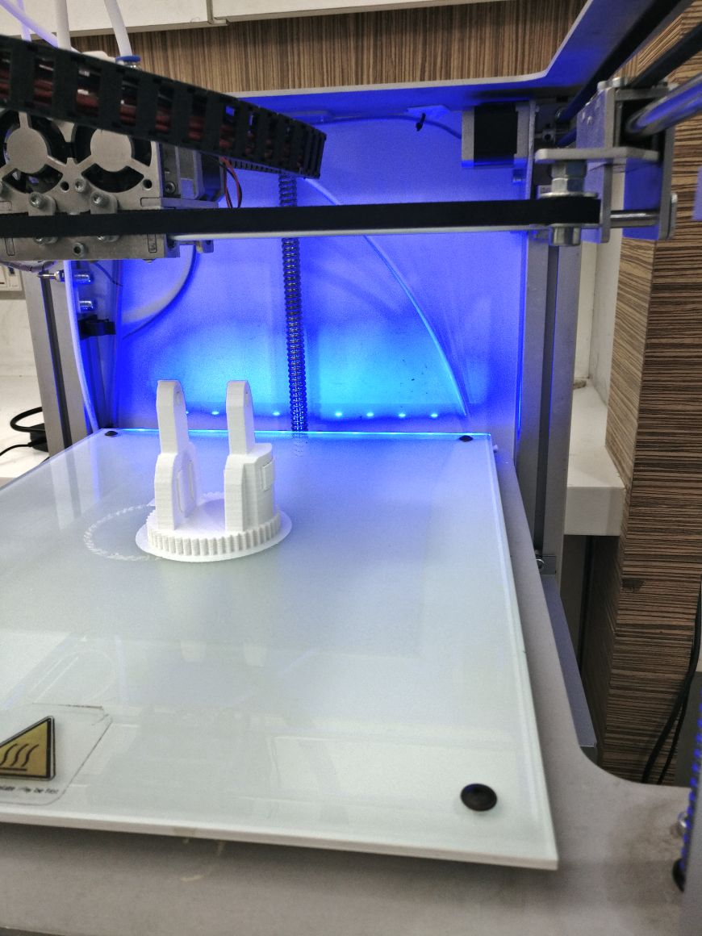
3D printing process

Slide 9
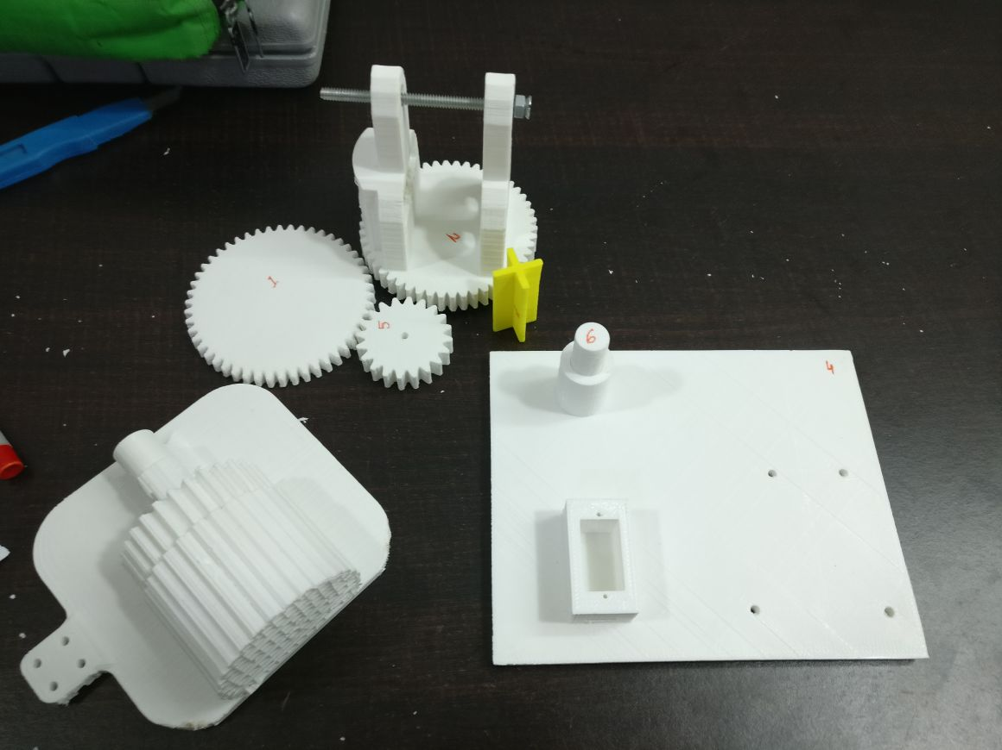
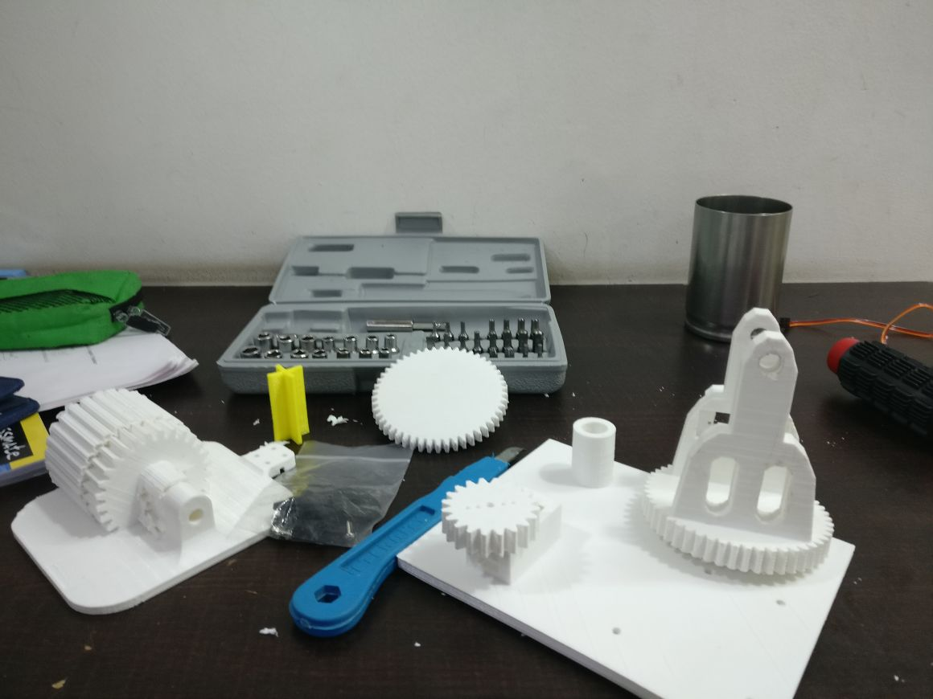

Slide 10
WORKING
Dual-axis trackers continually face the sun because they can move in two different directions. Types include tip-tilt and azimuth-altitude. Dual-axis tracking is typically used to orient a mirror and redirect sunlight along a fixed axis towards a stationary receiver. Because these trackers follow the sun vertically and horizontally they help obtain maximum solar energy generation.
Our tracker is controlled by a microcontroller brain i.e. the blue Arduino UNO chip that uses Embedded C programming to command the electronic parts in the project.We connected the Arduino to 4 Light-Dependent Resistors to gather data about the relative amounts of light in each quadrant. Based on this information, we programmed the microcontroller to run the servos in the X and Y axes accordingly so that the device, as a whole, orients itself to the direction of the source of the light. We used a safety potentiometer to hold the one of the servo's position in place and pre-programmed one of the servos to follow a scheduled path. This helps reduce misinterpretation of data.

Slide 11
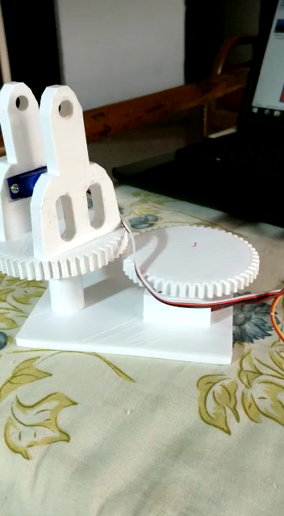

Slide 12
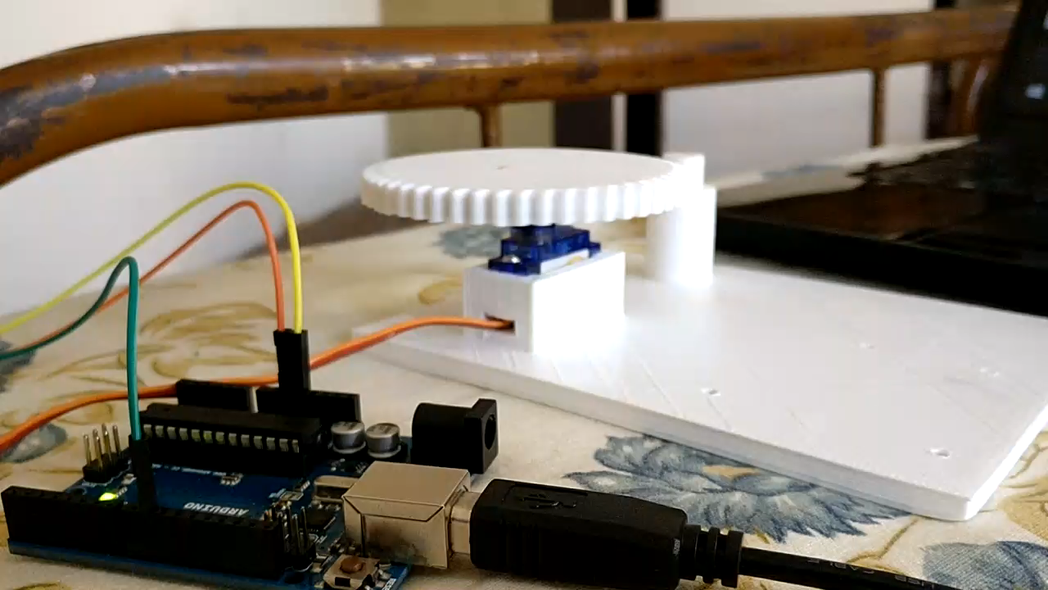

Slide 13
FINAL RESULTS
Dual Axis Solar Tracker project is to provide an efficient solar distributed generation system. At maximum, the solar tracker is perpendicular to the light source. The built system has a calculated annual energy gain of 48.982% compared to an immobile solar panel. Compared to a single axis tracker, the dual-axis tracker has an annual energy gain of 36.504%.
The purpose of a solar tracker is to accurately determine the position of the sun. This enables solar panels interfaced to the tracker to obtain the maximum solar radiation. With this particular solar tracker a closed-loop system was made consisting of an electrical system and a mechanical system with the help of electronics.

Slide 14
External Credits:
We Thank Swapnil Prabhudesai Sir for his guidance and support
-Prachin Patil Sir:-3D Printing In-Charge Faculty.
-‎Mahanty Sir:- HOD of Mechanical Engineering.
-Mannat Bagga from Innovation Cell- Guide and Mentor.
-‎Aniketh Nair from Innovation Cell-Help for Arduino Microcontroller.
-‎Brijkumar Sir-3D Editing and SolidWorks Faculty.
-‎Mudit Garg from Innovation Cell for Permissions.

